Slide 1
HR Analytics Dashboard
Project Architecture

Slide 2
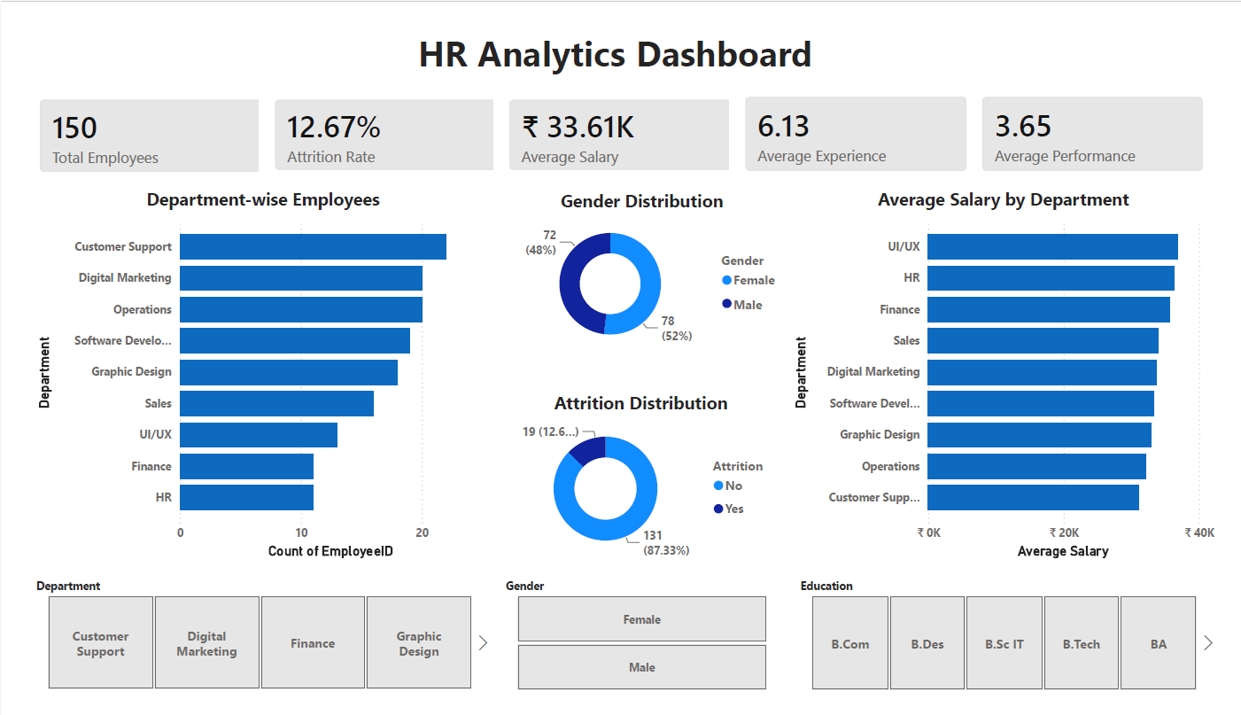
🗄 MySQL
🐍 Python
📊 Power BI
🌐 HTML / CSS
Project Objective
Analyse employee workforce data using SQL, Python, Power BI, and HTML reporting to provide insights into employee performance, salary trends, attrition, promotions, training, and workforce analytics.
KPIs
• Total Employees
• Attrition Rate
• Average Salary
• Average Experience
• Performance Score
• Work-Life Balance
• Training Hours

Slide 3
Project Workflow Architecture
Employee Data
MySQL Database
SQL Analysis
Python Processing
Power BI Dashboard
HTML/CSS Report

Slide 4
Technology Stack Used
Technology | Purpose
MySQL | Store Employee Data
SQL | Workforce Analysis
Python | Data Cleaning & EDA
Pandas | Data Processing
Matplotlib | Charts
Seaborn | Visualization
Power BI | Interactive Dashboard
HTML/CSS | Project Documentation

Slide 5
Skills Demonstrated
✓ Database Design
✓ SQL Querying
✓ Data Cleaning
✓ Exploratory Data Analysis
✓ Employee Performance Analysis
✓ Salary Analysis
✓ Attrition Analysis
✓ Dashboard Development
✓ Business Intelligence
✓ Data Visualization
✓ Professional Reporting

